Slide 1
Chapter 5 – System Modeling
Pepper modification of
Sommerville Software Engineering presentation
Chapter 5 System modeling
1

Slide 2
Topics covered
Context models
Interaction models
Structural models
Behavioral models
Model-driven engineering
Chapter 5 System modeling

Slide 3
Existing and planned system models
Model the existing system - clarify minimum needs and current process
Model the new system - discuss new system requirements
In a model-driven engineering process, use MDA (model driven architecture) to create code from the models.
Chapter 5 System modeling

Slide 4
System perspectives
External
  context and environment (context model)
Interaction
  Between system and its external environment (use case)
  Between the components of a system. (sequence diagram)
Structural
  organization of a system (class diagram)
  structure of the data
Behavioral
  Response to events (state diagram, activity diagram)
Chapter 5 System modeling

Slide 5
Use of graphical models
facilitating discussion
  Incomplete and incorrect models are OK as their role is to support discussion.
documenting an existing system
  accurate representation of the system but need not be complete.
basis for system implementation
  Models have to be both correct and complete.
Chapter 5 System modeling

Slide 6
Context models
Context models
  Show what lies outside the system boundaries.
  Does not show process or how the systems interact
Must first determine system boundaries
  Systems that need your system and those your system needs
  Profoundly effects system requirements
  Political judgment
    The boundary will often effect workflows in different departments
Chapter 5 System modeling

Slide 7
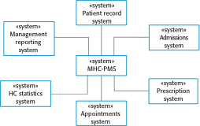
The context of the MHC-PMS
Chapter 5 System modeling

Slide 8
UML Activity Diagrams - behavior
Can be used to define high level business process or workflows
  Shows how the system will be used at a high level
  Order of activity made of many actions
  Different from flowcharts - Support parallel behavior
  Shows essential sequencing
Components
  Actions box - (can be a basis for another activity diagram)
  Process line
    Fork line - one in and several out - multiple actions can start
    Join line - close parallel actions - every action done by this line
  Condition diamonds - decisions
    Branch diamond - start conditional
    Merge diamond - join back to the flow
  Partition lines
    Illustrate which system does what
Chapter 5 System modeling

Slide 9
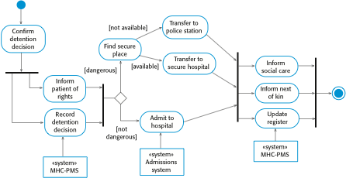
Process model of involuntary detention
Chapter 5 System modeling

Slide 10
Use case modeling - Interaction
Originally developed for requirements phase
  Shows system boundary
  Shows interactions with the outside world
Model discrete task - Set of scenarios with one goal
Actors (roles) may be people or other systems.
Diagram or Text
  Start with the main success case
  Write the other scenarios into the case as extensions
  Can include other already defined use cases
  Pre-condition / Guarantee at end / Trigger to start event
  Keep steps simple and show who is involved in each step
Chapter 5 System modeling

Slide 11

Transfer-data use case
A use case in the MHC-PMS
Chapter 5 System modeling

Slide 12
Tabular description of the ‘Transfer data’ use-case
MHC-PMS: Transfer data
Actors | Medical receptionist, patient records system (PRS)
Description | A receptionist may transfer data from the MHC-PMS to a general patient record database that is maintained by a health authority. The information transferred may either be updated personal information (address, phone number, etc.) or a summary of the patient’s diagnosis and treatment.
Data | Patient’s personal information, treatment summary
Stimulus | User command issued by medical receptionist
Response | Confirmation that PRS has been updated
Comments | The receptionist must have appropriate security permissions to access the patient information and the PRS.
Chapter 5 System modeling

Slide 13
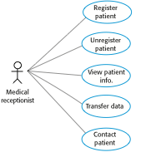
Use cases in the MHC-PMS involving the role ‘Medical Receptionist’
Chapter 5 System modeling

Slide 14
Sequence diagrams - Interaction
Sequence during a single scenario or use case
  See behavior of several objects in one use case
  Illustrate calls between participants and who is in charge of each step
  Do not illustrate algorithms, loops, and conditions well
The objects and actors (participants) at the top
Dotted line drawn vertically (lifeline) from each participant
  Rectangle over dotted line for activation of object
Interactions between objects -> annotated arrows
  Data passing can be listed on arrows. Can put a participant name on an arrow
  No need to determine how data is gathered, just that it is needed
  Use a return arrow if you feel it will be helpful
Read Top to bottom; starting top left
Alt box - can handle conditions; conditions in [ ]
Chapter 5 System modeling

Slide 15
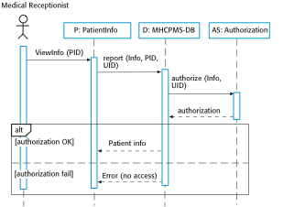
Sequence diagram for View patient information
Chapter 5 System modeling

Slide 16
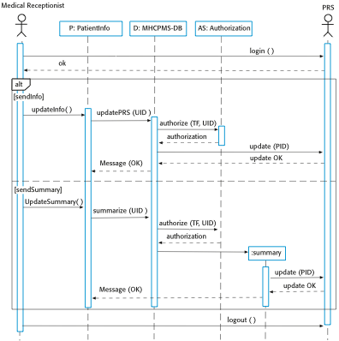
Sequence diagram for Transfer Data
Chapter 5 System modeling

Slide 17
Class diagrams - Structural
Class diagrams are used when developing an object-oriented system model to show the classes in a system and the associations between these classes.
An object class can be thought of as a general definition of one kind of system object.
An association is a link between classes that indicates that there is some relationship between these classes.
When you are developing models during the early stages of the software engineering process, objects represent something in the real world, such as a patient, a prescription, doctor, etc.
Chapter 5 System modeling

Slide 18
UML classes and association
Chapter 5 System modeling

Slide 19
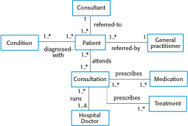
Classes and associations in the MHC-PMS
Chapter 5 System modeling

Slide 20

The Consultation class
Chapter 5 System modeling

Slide 21
Key points
Model definition - abstract view of a system that ignores system details. Types: system’s context, interactions, structure and behavior.
Context models - position in the environment
Behavior - Activity diagram shows workflow
Interaction - users (including other systems) and your system
  Use cases - who touches what
  Sequence diagrams - messages sent back and forth in a sequence.
Structural - organization and architecture of a system.
  Class diagrams - define the static structure of classes in a system and their association to other classes
Chapter 5 System modeling

Slide 22
Chapter 5 – System Modeling
Lecture 2
Chapter 5 System modeling

Slide 23
Generalization
Generalization is an everyday technique that we use to manage complexity.
Rather than learn the detailed characteristics of every entity that we experience, we place these entities in more general classes (animals, cars, houses, etc.) and learn the characteristics of these classes.
This allows us to infer that different members of these classes have some common characteristics e.g. squirrels and rats are rodents.
Chapter 5 System modeling

Slide 24
Generalization
In modeling systems, it is often useful to examine the classes in a system to see if there is scope for generalization. If changes are proposed, then you do not have to look at all classes in the system to see if they are affected by the change.
In object-oriented languages, such as Java, generalization is implemented using the class inheritance mechanisms built into the language.
In a generalization, the attributes and operations associated with higher-level classes are also associated with the lower-level classes.
The lower-level classes are subclasses inherit the attributes and operations from their superclasses. These lower-level classes then add more specific attributes and operations.
Chapter 5 System modeling

Slide 25
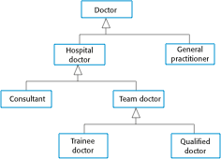
A generalization hierarchy
Chapter 5 System modeling

Slide 26
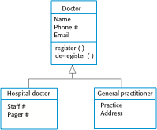
A generalization hierarchy with added detail
Chapter 5 System modeling

Slide 27
Object class aggregation models
An aggregation model shows how classes that are collections are composed of other classes.
Aggregation models are similar to the part-of / has –a relationship in semantic data models.
Use a diamond at the containing side
Fill the diamond if the part cannot exist without the whole
Chapter 5 System modeling

Slide 28

The aggregation association
Chapter 5 System modeling

Slide 29
Behavioral models
Behavioral models – how a system responds to stimulus
You can think of these stimuli as being of two types:
  Data Some data arrives that has to be processed by the system.
  Events Some event happens that triggers system processing. Events may have associated data, although this is not always the case.
Diagrams - Input through to output
  Activity Diagram used on data
    Data (object / box) and Action ( oval )
  Sequence diagram
    Data (top box ) and Actions (arrows)
Chapter 5 System modeling

Slide 30
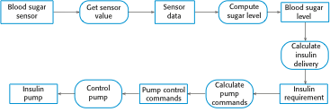
An activity model of the insulin pump’s operation
Chapter 5 System modeling

Slide 31
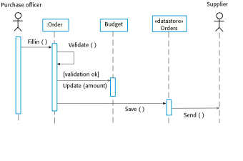
Order processing
Chapter 5 System modeling

Slide 32
Event-driven modeling
Real-time systems are often event-driven, with minimal data processing. For example, a landline phone switching system responds to events such as ‘receiver off hook’ by generating a dial tone.
Event-driven modeling shows how a system responds to external and internal events.
It is based on the assumption that a system has a finite number of states and that events (stimuli) may cause a transition from one state to another.
Chapter 5 System modeling

Slide 33
State machine models
These model the behaviour of the system in response to external and internal events.
They show the system’s responses to stimuli so are often used for modelling real-time systems.
State machine models show system states as nodes and events as arcs between these nodes. When an event occurs, the system moves from one state to another.
Statecharts are an integral part of the UML and are used to represent state machine models.
Chapter 5 System modeling

Slide 34
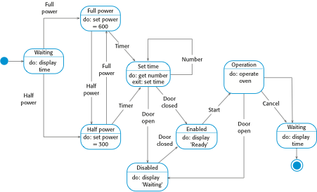
State diagram of a microwave oven
Chapter 5 System modeling

Slide 35
States and stimuli for the microwave oven (a)
State | Description
Waiting | The oven is waiting for input. The display shows the current time.
Half power | The oven power is set to 300 watts. The display shows ‘Half power’.
Full power | The oven power is set to 600 watts. The display shows ‘Full power’.
Set time | The cooking time is set to the user’s input value. The display shows the cooking time selected and is updated as the time is set.
Disabled | Oven operation is disabled for safety. Interior oven light is on. Display shows ‘Not ready’.
Enabled | Oven operation is enabled. Interior oven light is off. Display shows ‘Ready to cook’.
Operation | Oven in operation. Interior oven light is on. Display shows the timer countdown. On completion of cooking, the buzzer is sounded for five seconds. Oven light is on. Display shows ‘Cooking complete’ while buzzer is sounding.
Chapter 5 System modeling

Slide 36
States and stimuli for the microwave oven (b)
Stimulus | Description
Half power | The user has pressed the half-power button.
Full power | The user has pressed the full-power button.
Timer | The user has pressed one of the timer buttons.
Number | The user has pressed a numeric key.
Door open | The oven door switch is not closed.
Door closed | The oven door switch is closed.
Start | The user has pressed the Start button.
Cancel | The user has pressed the Cancel button.
Chapter 5 System modeling

Slide 37
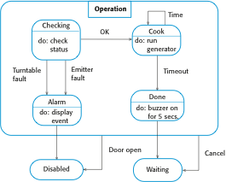
Microwave oven operation – use superstate
Chapter 5 System modeling

Slide 38
Usage of model-driven engineering
MDE
  Raise level of abstraction in program spec
  Increase automation in programming
Pros
  Allows systems to be considered at higher levels of abstraction
  Generating code automatically means that it is cheaper to adapt systems to new platforms.
Cons
  Models for abstraction and not necessarily right for implementation.
  Savings from generating code may be outweighed by the costs of developing translators for new platforms.
Chapter 5 System modeling

Slide 39
Model driven architecture (used by MDE)
MDA is a model-focused approach to software design and implementation that uses a subset of UML models to describe a system.
Models at different levels of abstraction are created. From a high-level, platform independent model, it is possible, in principle, to generate a working program without manual intervention.
Chapter 5 System modeling

Slide 40
Types of model
A computation independent model (CIM)
  These model the important domain abstractions used in a system. CIMs are sometimes called domain models.
A platform independent model (PIM)
  These model the operation of the system without reference to its implementation. The PIM is usually described using UML models that show the static system structure and how it responds to external and internal events.
Platform specific models (PSM)
  These are transformations of the platform-independent model with a separate PSM for each application platform. In principle, there may be layers of PSM, with each layer adding some platform-specific detail.
Chapter 5 System modeling

Slide 41
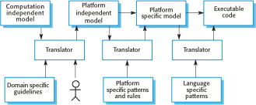
MDA transformations
Chapter 5 System modeling

Slide 42
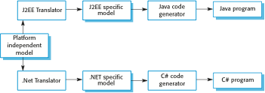
Multiple platform-specific models
Chapter 5 System modeling

Slide 43
Agile methods and MDA
The developers of MDA claim that it is intended to support an iterative approach to development and so can be used within agile methods.
The notion of extensive up-front modeling contradicts the fundamental ideas in the agile manifesto and I suspect that few agile developers feel comfortable with model-driven engineering.
If transformations can be completely automated and a complete program generated from a PIM, then, in principle, MDA could be used in an agile development process as no separate coding would be required.
Chapter 5 System modeling

Slide 44
Executable UML
The fundamental notion behind model-driven engineering is that completely automated transformation of models to code should be possible.
This is possible using a subset of UML 2, called Executable UML or xUML.
Chapter 5 System modeling

Slide 45
Features of executable UML
To create an executable subset of UML, the number of model types has therefore been dramatically reduced to these 3 key types:
  Domain models that identify the principal concerns in a system. They are defined using UML class diagrams and include objects, attributes and associations.
  Class models in which classes are defined, along with their attributes and operations.
  State models in which a state diagram is associated with each class and is used to describe the life cycle of the class.
The dynamic behavior of the system may be specified declaratively using the object constraint language (OCL), or may be expressed using UML’s action language.
Chapter 5 System modeling

Slide 46
Key points
Behavioral models are used to describe the dynamic behavior of an executing system. This behavior can be modeled from the perspective of the data processed by the system, or by the events that stimulate responses from a system.
Activity diagrams may be used to model the processing of data, where each activity represents one process step.
State diagrams are used to model a system’s behavior in response to internal or external events.
Model-driven engineering is an approach to software development in which a system is represented as a set of models that can be automatically transformed to executable code.
Chapter 5 System modeling

